Slide 1
Wireless Security

Slide 2
Basic Concept of Wireless LAN
WLAN
A type of Local Area Network
Wi-Fi is the implementation of WLAN
Use high frequency Radio Wave (RF)
Speed: 11Mbps to ~11Gbps
Range: 10m (802.11ad) to 5km (802.11y)

Slide 3
IEEE 802.11 family (See Wiki IEEE 802.11)
802.11b
2.4 GHz
Up to 11Mbps
802.11a
5-6 GHz
Up to 54Mbps
802.11g
2.4 GHz
Up to 54Mbps
802.11n
2.4 / 5 GHz
Up to ~600Mbps

Slide 4
802.11ac
5GHz
Up to ~1.3Gbps
802.11ad
60GHz
Much shorter range and difficult to pass through obstacles
Up to ~7Gbps
802.11ax
2.4 / 5 GHz
Up to ~11Gbps

Slide 5
Channel
Each frequency range is divided into different channels
Different countries have different regulations to the allowable channels
Source: http://www.pisa.org.hk/event/wlan_workshop.ppt

Slide 6
Ad Hoc Mode
Client to client communication
Wireless devices can directly communicate with each other
No access point is needed

Slide 7
Infrastructure Mode
Connect to Access Point (AP)
Most of the wireless networks are connected in this way

Slide 8
Access Point (AP)
Serves as a “hub” for wireless clients.
Bridge between wired and wireless LANs.
Beacon
A message transmitted at regular intervals by the APs.
Contain information about the network.
Used to maintain, to optimize communications, and to automatically connect to the AP.
Clients can join WLAN by
Listening to beacon passively, OR
Sending a probe request and then wait for a probe response.
Notes:
Hub: repeat the data packet to ALL connected devices
Switch: only send the data packet to the target device

Slide 9
SSID (Service Set Identifier)
Also known as Network Name
Up to 32 characters
Usually in form of natural language
BSSID (Basic Service Set Identifier)
6 bytes in form of a MAC address
BSS (Basic Service Set)
The set of clients and one AP that have recognized each other and have established communications
ESS (Extended Services Set)
Series of overlapping BSS connected by a distributed system

Slide 10
Security Protocols
Provide security measures such as encryption
Wired Equivalent Privacy (WEP)
Broken, can be cracked in few minutes
Wi-Fi Protected Access (WPA)
Released in 2003
Has some security issues (when RC4-TKIP is used)
Wi-Fi Protected Access II (WPA2)
Released in 2004
Most popular nowadays
More secure than WPA (when AES-CCMP is used)
Wi-Fi Protected Access 3 (WPA3)
Released in 2018
Most secure

Slide 11
War Driving
Originally, War Driving referred to the case that crackers drove around in a car equipped with wireless gear looking for unsecured wireless networks, to gain illicit access
Nowadays, the term has evolved to include harmless types that simply checking on the WLAN environment

Slide 12
To perform war driving, we need to have:
Device capable of
receiving 802.11 signal
moving around
Software that will log data from the device
Vistumber
WifiInfoView
Over time, we can build up a database that consists of the network name, the location, the signal strength, the encryption protocol used, etc.

Slide 13
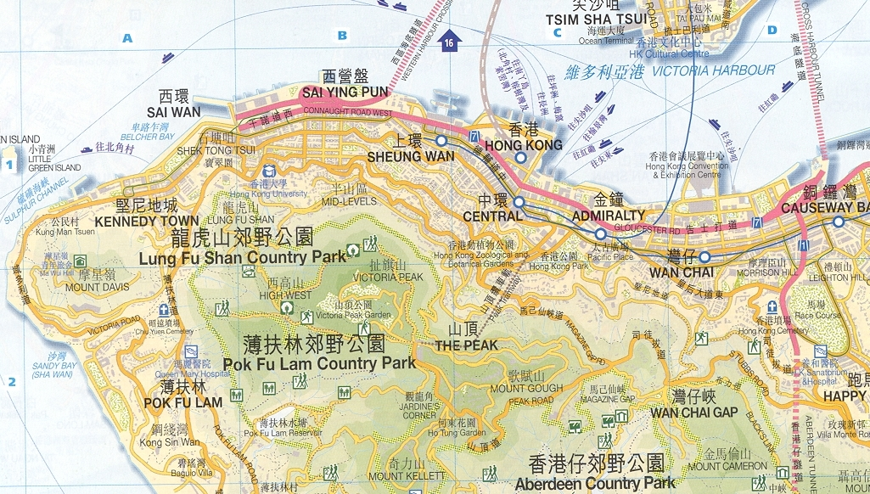
Professional Information Security Association (PISA) tried her first war driving in Hong Kong in 2002
2002 survey
187 access points captured
WEP enable: 22.99%
WEP disable: 77.01%
Notes:
Reference:
http://www.pisa.org.hk/event/wlan_workshop.ppt

Slide 14
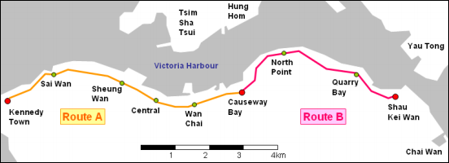
2016 survey
51,322 access points captured
With Encryption: 83.68%
WEP: 3.10%
WPA: 31.69%
WPA2: 48.89%
Without Encryption: 16.32%
Notes:
Reference:
http://www.safewifi.hk/files/2017/Report%20on%20Wireless%20LAN%20War%20Driving%20Survey%202016%20Hong%20Kong.pdf
http://dl.aircrack-ng.org/breakingwepandwpa.pdf

Slide 15
Wireless Router Configuration
Enable WPA3 (for new routers only)
For current routers, enable WPA2 using AES-CCMP with a strong Pre-Shared Key (PSK)
Disable Wi-Fi Protected Setup (WPS / QSS)
WPS is a key exchange mechanism providing an easy setup of a Wi-Fi network
In 2011, a major security flaw was found allowing unauthorized access to the network
Many old routers have WPS enabled by default, some may even have no option to disable it
According to PISA in 2016 survey, 33.02% of in the discovered routers still have WPS enabled

Slide 16
Enable firewall functioning
Make sure that the router's firmware is up-to-date
Enable MAC address filtering
Only devices with authorized MAC addresses are allowed to connect to the router
Only avoid unauthorized “normal users” connecting to your WLAN
Not a reliable security measure against hackers
Tools can be used to discover the MAC addresses wirelessly
Hackers can change their MAC addresses accordingly
Other security measures are still needed

Slide 17
Network Name Broadcast (Enable / Disable)
The router broadcasts its network name to nearby client devices regularly
Hide the SSID = Disable this feature
There are pros and cons for hiding the SSID
Pros
Avoid “normal users” from knowing the existence of the WLAN
Lower the chance to be targeted by the hackers who want to hack into some “easy-targets”
The hacker needs to take an extra step to search for hidden networks
By hiding the network, it at least shows that the network owner knows how to configure the router, where the chance for this router to be set up securely is higher → may not be an “easy-target”

Slide 18
Cons
If your WLAN is already being targeted, it is not a reliable security measure against hackers
For the client devices, some OSs may broadcast the probe request (that contains the network name) of the hidden network anywhere for them to connect the hidden network
For example, your mobile phone may broadcast the probe request of your home network even you are in school
This may cause privacy issues
But some say that some OSs nowadays broadcast the probe request of a network anywhere no matter whether it is a hidden network or not

Slide 19
Wired Equivalent Privacy (WEP)
WEP is used in the original 802.11 network to protect link-level data during wireless transmission
Diagram on the next page
WEP relies on a secret key k shared between the communicating parties

Slide 20
Client
Server
Application
Application
Transport
(TCP, UDP)
Transport
(TCP, UDP)
Wireless Router
Network (IP)
Network (IP)
Network (IP)
Network (IP)
802.11 Link
802.11 Link
Ethernet
Link
Ethernet
Link
WPA3/WPA2/
WPA/WEP
WPA3/WPA2/
WPA/WEP
Ethernet
Physical
Ethernet
Physical
Ethernet
Physical
Ethernet
Physical
Modified from http://www.pisa.org.hk/event/wlan_workshop.ppt

Slide 21
Initialization Vector (IV)
k: secret key
Plaintext
Message
CRC
XOR
Keystream = RC4(IV, k)
IV
Ciphertext
Transmitted Data

Slide 22
Checksumming
Compute an integrity checksum c(M) on the message M.
Concatenate the two to obtain a plaintext
P = <M,c(M)>
Plaintext
Message
CRC

Slide 23
Encryption
Choose an Initialization Vector (IV)
IV must be different for every message transmitted
802.11 standard doesn't specify how IV is calculated
Wireless cards use several methods
Some use a simple ascending counter for each message
Some switch between alternate ascending and descending counters
Some use a pseudo random IV generator
RC4 algorithm generates a keystream: RC4(IV, k)
Long sequence of pseudorandom bytes
A function of IV and k
Exclusive-OR the plaintext with the keystream to obtain the ciphertext C:
Notes:
P: 0 0 1 1
RC4(IV,k): 0 1 0 1
C: 0 1 1 0

Slide 24
Transmission
Transmit the IV and the ciphertext over the radio link
Decryption
Get the Initialization Vector (IV)
Know the shared key k
RC4 algorithm generates the same keystream: RC4(IV, k)
Exclusive-OR the ciphertext with the keystream to obtain the plaintext:
The reverse of exclusive-OR is also exclusive-OR
Notes:
P: 0 0 1 1
RC4(IV,k): 0 1 0 1
C: 0 1 1 0

Slide 25
Weakness of WEP
Invariance weakness
Existence of a large class of weak keys
A small part of the secret key determines a large number of bits of the initial permutation
The patterns resulted from the weak keys propagate into the generated stream
The occurrences of these patterns can be easily distinguished
In other words, a small number of weak key bits determine a large number of bits in the output stream

Slide 26
IV weakness
Related key vulnerability
When the same secret part of the key is used with numerous exposed IVs (24-bit only), the attacker can re-derive the secret part by analyzing the key-streams with relatively little work
Open-source implementations of the attack are widely available
Such as AirSnort and Aircrack-ng
The bottleneck for key recovery is to gather weakly-encrypted frames
Can be cracked in few minutes
Notes:
Reference:
Scott Fluhrer, Itsik Mantin, and Adi Shamir. Weaknesses in the Key Scheduling Algorithm of RC4. SAC 2001.

Slide 27
802.11i
WEP is part of the original 802.11 standard
A new standard 802.11i should be used nowadays
802.1X Port-Based Network Access Control
For validation of client and user credentials to prevent unauthorized access to a specified router port
Notes:
Reference:
http://tldp.org/HOWTO/html_single/8021X-HOWTO/

Slide 28
Encryption
Temporary Key Integrity Protocol (TKIP)
Still use RC4 as cryptographic algorithm
More complex scheme with message authentication, and longer IV (48-bit vs. 24-bit)
Considered not secure, deprecated in 2012
Default encryption scheme for WPA
WPA (with TKIP) is called Transitional Security Network (TSN)
Counter Mode with CBC-MAC protocol (CCMP)
Use AES as cryptographic algorithm
More CPU intensive
Default encryption scheme for WPA2
WPA2 (with CCMP) is called Robust Secure Network (RSN)
Notes:
Reference:
http://tldp.org/HOWTO/html_single/8021X-HOWTO/

Slide 29
WPA/WPA2-PSK
Pre-shared key / Personal
The same key among all users
Suitable for home or small companies
A strong key should be used to avoid dictionary attack
At least 12-14 characters containing uppercase letters, lowercase letters, special characters, and digits
WPA/WPA2-Enterprise
Different users have different keys
Authentication server (RADIUS)
Notes:
Reference:
http://tldp.org/HOWTO/html_single/8021X-HOWTO/

Slide 30
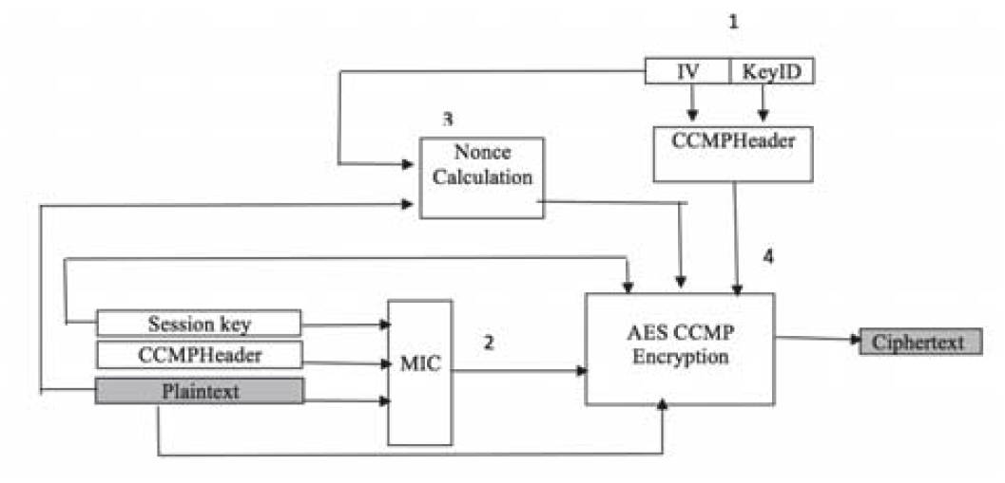
Wi-Fi Protected Access II (WPA2)
Image source: Samia Alblwi, Khalil Shujaee. A Survey on Wireless Security Protocol WPA2. SAM17.
Notes:
Step 1: The initialization vector (IV), which contains 48-bit replay protection, and the index (KeyID) are used to construct the CCMP header.
Step 2: The CCMP header, session key, and plaintext are used to compute the Message Integrity Code (MIC).
Step 3: IV and plaintext are used to generate the nonce.
Step 4: Plaintext, session key, the MIC, nonce, and the CCMP header are encrypted using AES in order to produce the cipher text.

Slide 31
Step 1: The initialization vector (IV), which contains 48-bit replay protection, and the index (KeyID) are used to construct the CCMP header.
Step 2: The CCMP header, session key, and plaintext are used to compute the Message Integrity Code (MIC).
Step 3: IV and plaintext are used to generate the nonce.
Step 4: Plaintext, session key, the MIC, nonce, and the CCMP header are encrypted using AES in order to produce the cipher text.

Slide 32
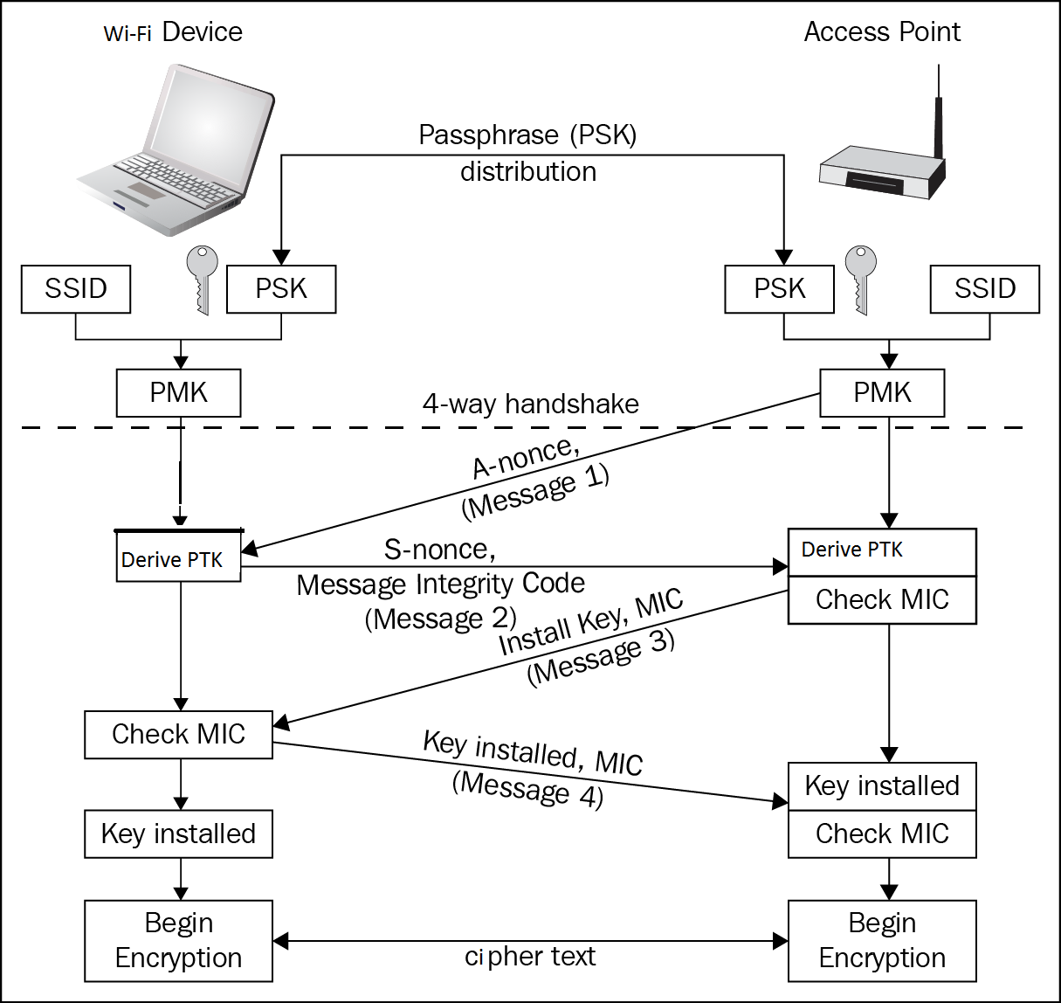
WPA/WPA2 4-way Handshake
Image Source:. https://www.packtpub.com/books/content/common-wlan-protection-mechanisms-and-their-flaws
Notes:
For both parties to know the other one has the correct PSK
Without sending PSK and PMK out
To generate PTK, which is used to derive the encryption key later
PSK (Pre-shared Key)
PMK (Pairwise Master Key)
Derived by SSID and PSK using a hash function
A-nonce, S-nonce
Random integers
PTK (Pairwise Transient Key)
Derived by PMK, A-nonce, S-nonce, client MAC address, and AP MAC address
Used for deriving other keys for AES-CCMP / TKIP encryption later

Slide 33
For both parties to know the other one has the correct PSK
Without sending PSK and PMK out
To generate PTK, which is used to derive the encryption key later
PSK (Pre-shared Key)
PMK (Pairwise Master Key)
Derived by SSID and PSK using a hash function
A-nonce, S-nonce
Random integers
PTK (Pairwise Transient Key)
Derived by PMK, A-nonce, S-nonce, client MAC address, and AP MAC address
Used for deriving other keys for AES-CCMP / TKIP encryption later
Notes:
Reference:
https://www.packtpub.com/books/content/common-wlan-protection-mechanisms-and-their-flaws
http://etutorials.org/Networking/Wireless+lan+security/Chapter+8.+WLAN+Encryption+and+Data+Integrity+Protocols/Key+Management/

Slide 34
Attack on WPA / WPA2
Key Reinstallation Attack (KRACK)
Discovered in 2016
Man-in-the-middle attack
Allows decryption, packet replay, TCP connection hijacking, HTTP content injection, etc.
Affects all major platforms
Windows, Linux, macOS, Android, iOS, etc.
Linux and Android affected mostly due to their widely used open-source implementation wpa_supplicant
Nevertheless, WPA / WPA2 is still more secure than WEP
Can be fixed by applying patches to OS and routers
Notes:
Reference:
https://www.krackattacks.com/

Slide 35
Against the 4-way handshake of WPA / WPA2
After the client receives Message 3, the key will be installed
The protocol allows Message 3 to be received multiple times
Each time will reinstall the same encryption key, and reset
the incremental transmit packet number (nonce)
receive replay counter
used by the encryption protocol
If the same encryption key is used with nonce values that have already been used in the past, the encryption protocols will reuse the previous keystream when encrypting packets
Notes:
Reference:
https://www.krackattacks.com/

Slide 36
In case a message that reuses keystream has known content, it becomes trivial to derive the used keystream
In practice, finding packets with known content is not a problem
This keystream can then be used to decrypt messages with the same nonce
Notes:
Reference:
https://www.krackattacks.com/

Slide 37
Wi-Fi Protected Access 3 (WPA3)
Use Simultaneous Authentication of Equals (SAE) instead of PSK 4-way handshake in WPA/WPA2
Also known as Dragonfly key exchange
Can prevent Offline Dictionary Attack
WPA/WPA2 handshake can be captured
An attacker can perform offline dictionary attack to guess the PSK without any time limitation
Notes:
Reference:
https://tools.ietf.org/html/rfc7664
https://spectrum.ieee.org/tech-talk/telecom/security/everything-you-need-to-know-about-wpa3

Slide 38
Provide Forward Secrecy
If the key is compromised in one session, the security of earlier sessions will not be affected
WPA/WPA2 does not provide forward secrecy
An attacker can store the encrypted traffic first and then decrypt it later after the key is compromised
SAE provides forward secrecy by generating new keys for different sessions
Provide 192-bit security instead of 128-bit
For WPA3-Enterprise only
Notes:
Reference:
https://tools.ietf.org/html/rfc7664
https://spectrum.ieee.org/tech-talk/telecom/security/everything-you-need-to-know-about-wpa3

